Slide 1
Consistence in NoSQL
-Satyendra Singh

Slide 2
RDBMS = ACID
NoSQL = BASE

Slide 3
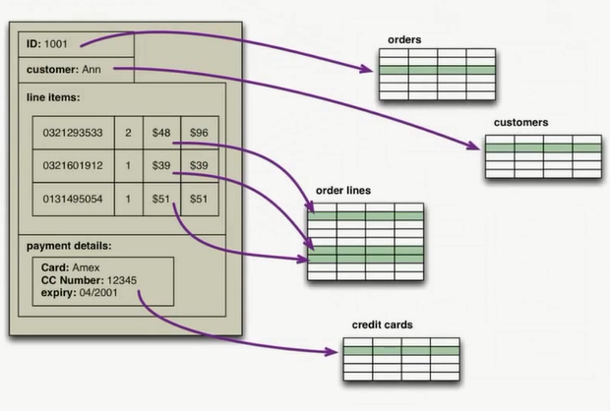

Slide 4
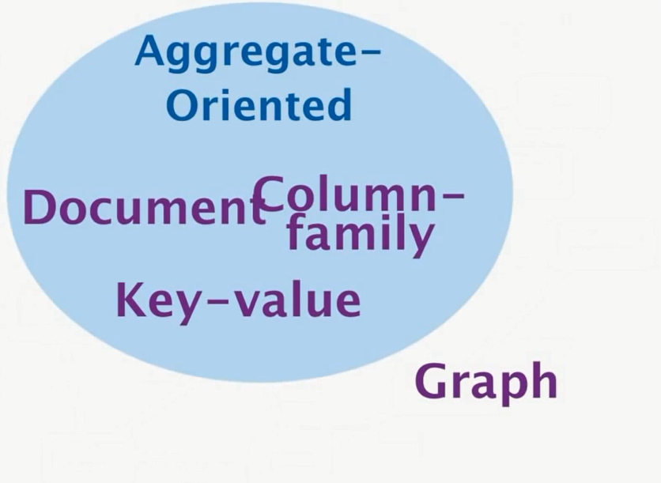
ACID

Slide 5
Types of Consistency
Logical
Occurs in distributed and single server machine.
Replication and/or Sharding
Occurs in distributed server machine.
Sharding means putting one copy of data on a single machine in a cluster.
Replication means putting multiple copy of data on different machines in a cluster

Slide 6
New Problem in Consistency
As soon as we replicate data in a cluster, a new type of consistency problem comes out.

Slide 7
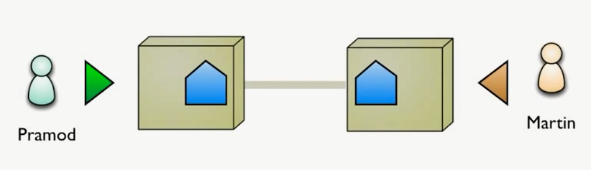
Scenario 1

Slide 8
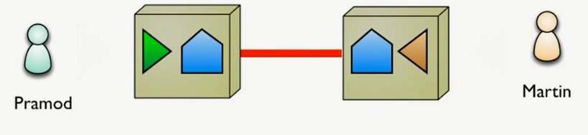
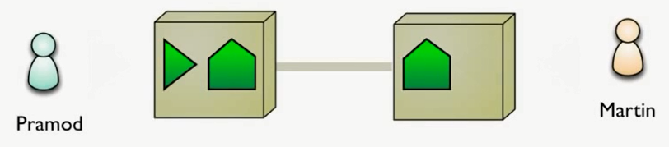
Scenario 1

Slide 9
Scenario 2

Slide 10
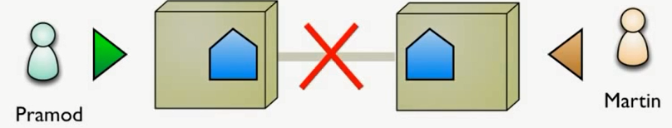
Scenario 2

Slide 11
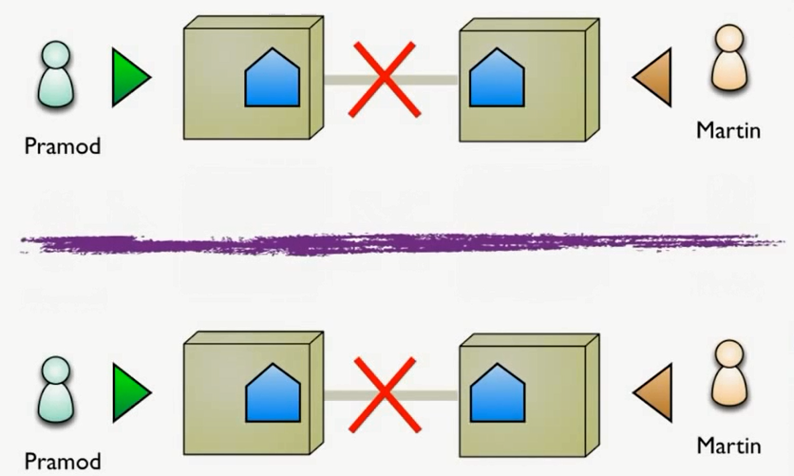
Scenario 2

Slide 12
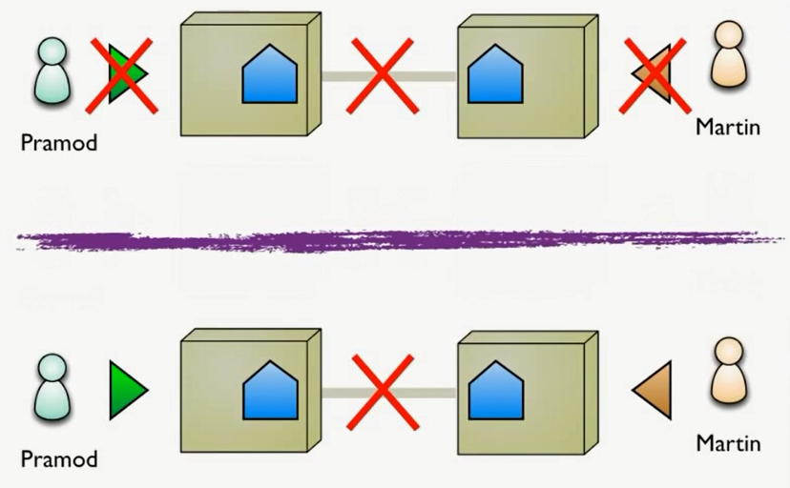
Scenario 2 - 1

Slide 13
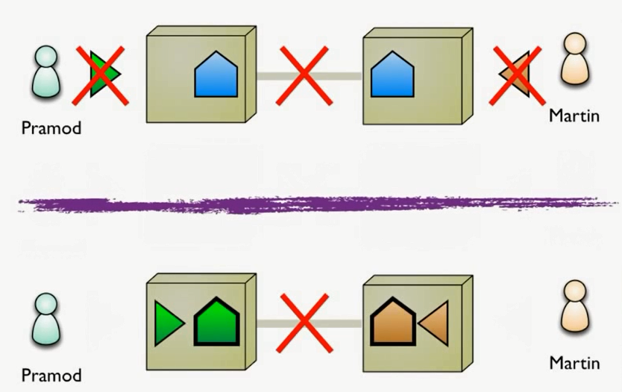
Scenario 2 - 2

Slide 14
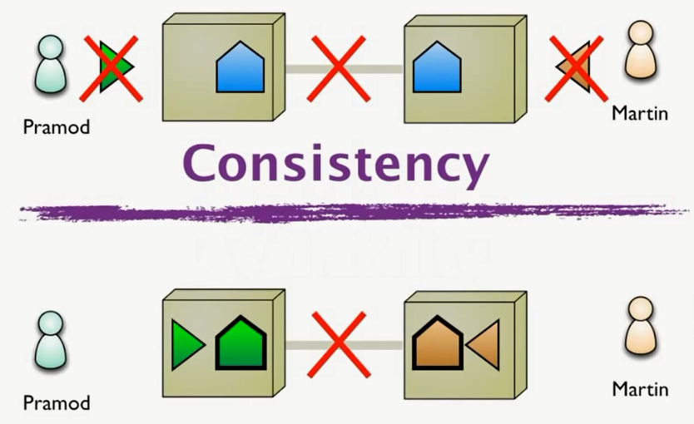
Scenario 2-1 is concern of Consistency

Slide 15
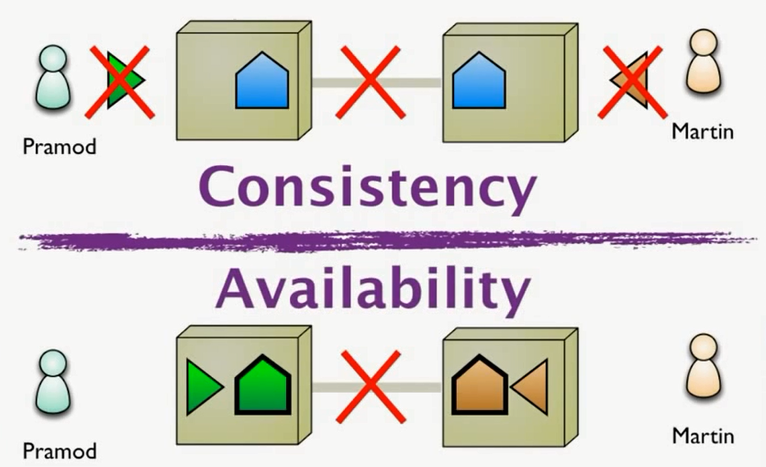
Scenarion 2-2 is concern of Availability

Slide 16
2 Choices
You prefer Consistency and Unavailability
You prefer Inconsistency and Availability
You have to make choice based on your business requirement.
It is a domain choice, and it is business people who has to decide what they prefer.

Slide 17
CAP Theorem
C – Consistency
A – Availability
P – Partition Tolerance

Slide 18
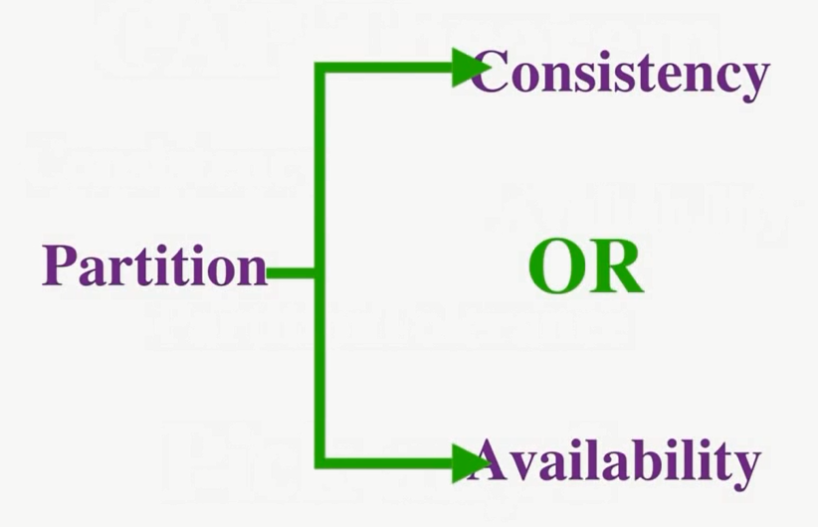

Slide 19
Is this the only choice?
You can arrange the level of Consistency and Availability as per your need.
But, The more consistency you ask for the less would be the response time, as multiple machines has to do conversation.
So, again it is up to domain and business people, they want to go for slow response or want to be very quick.

Slide 20
How to achieve consistency
Relaxing Durability.
Eventual Consistency.
Quorums.
Read-Your-Writes Consistency.

Slide 21
Is NoSQL going to replace RDBMS?
Data Analytics
Polyglot Persistence

